Slide 1

Data Analytics
Data Analytics

Slide 2
Outline
Data Analytics Definition
Steps of Data Analytics
Types of Data Analytics
Subsets of Data Analytics
Applications of Data Analytics
Concluding Remarks

Slide 3
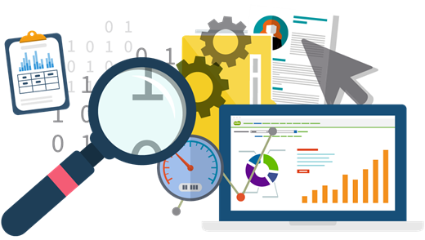
What is Data Analytics?
Analytics is the use of:
Data
Information technology
Statistical analysis
Quantitative methods
Mathematical or computer-based models
To help managers:
Gain improved insight about their business operations
Make better, fact-based decisions.

Slide 4
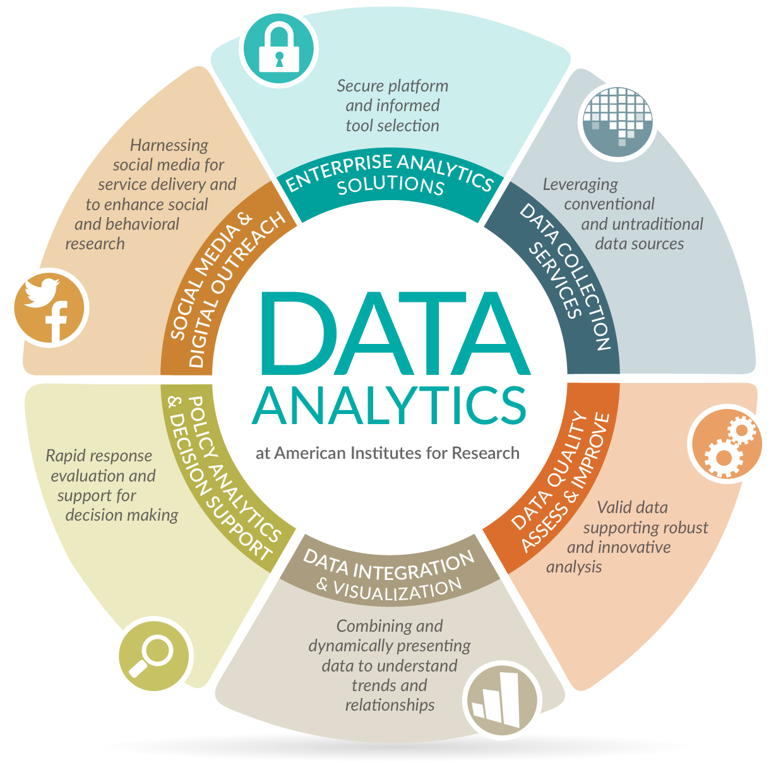

Slide 5
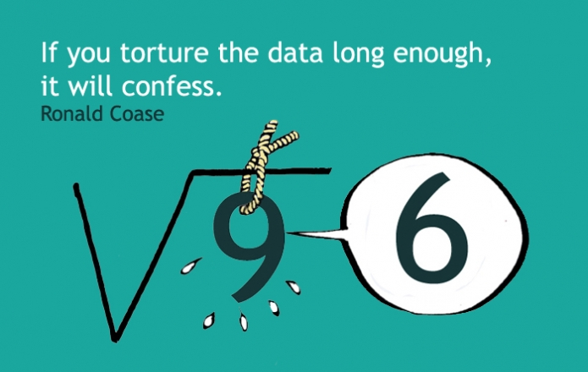
Ronald Coase - Economist & author, Winner of Nobel Memorial Prize in Economic Sciences.

Slide 6
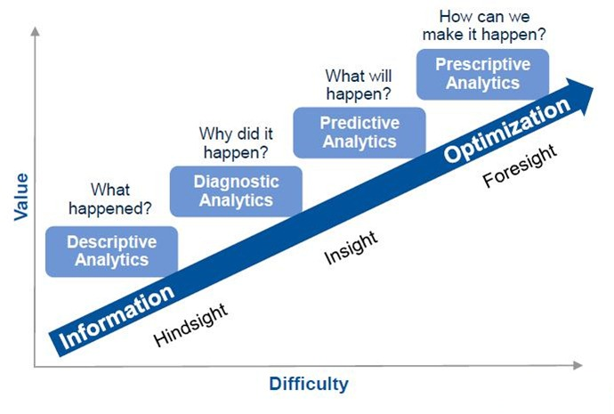
Data Analytics Capabilities

Slide 7
Steps of Data Analytics

Slide 8
1
Goals setting
Vital, understandable, simple, short, and measurable goals
2
4
5
6
3
Setting priorities for measurements
Decide what to measuring, and what methods to use for measure it
Data gathering
Available datasets, recording/generating data
Data cleansing
Outlier rejection, missing values interpolation, data structuring
Data analysis
Data mining, business intelligence, data visualization, exploratory data analysis
Precise results’ interpretation
Checking whether they are helpful in meeting initial objectives, results limiting, or inconclusive

Slide 9

1. Goal Setting
The business unit has to decide on objectives for the data analytics.
These objectives might be set out in question format
For example, if a business is struggling to sell its products, some relevant questions may be:
Are we overpricing our goods?
How is the competition’s product different to ours?
To answer the question, “Are we overpricing our goods?” business company have to gather data of:
Production costs
Details about the price of similar goods on the market.

Slide 10

2. Setting Priorities for Measurements
Determining what type of data is needed to answer the questions regarding objectives.
How much time to take for the analysis of the project.
The units of measurement going to be using.

Slide 11
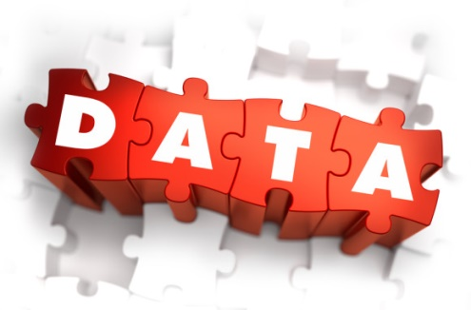
3. Data Gathering
Data can be already available datasets
Data can be generated by:
The direct or interview method
Company would interview “shoppers” regarding their favorite brand of toothpaste.
The indirect or questionnaire method
The questionnaire are distributed to the respondents either by personal delivery or by mail/email.
The registration method
The registration records kept by government organizations, e.g., NADRA.
The experimental method
Experimentation, simulation.

Slide 12

4. Data Cleansing
Data cleansing process identifying:
Incomplete
Incorrect
Inaccurate
Irrelevant parts of the data
The dirty or coarse data is:
Replaced
Modified
Or deleted.

Slide 13
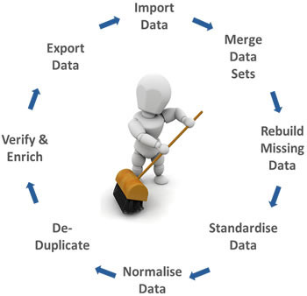
Data Cleansing Cycle

Slide 14
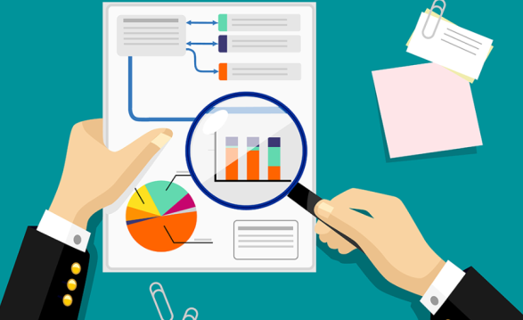
5. Data Analysis
Data analysis is process of:
Evaluating data using:
Analytical reasoning
Logical reasoning
To examine each component of the data provided.

Slide 15
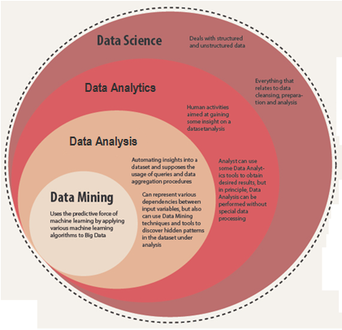

Slide 16
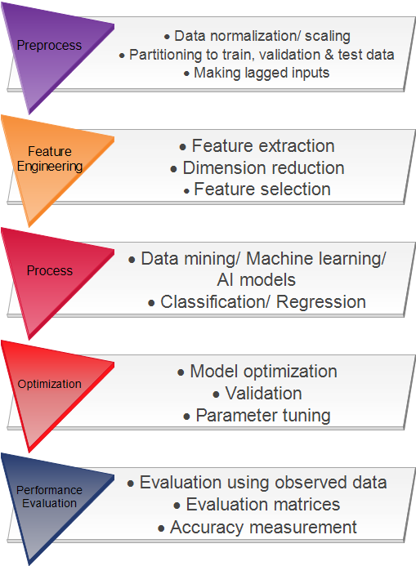
Steps of Data
Analysis

Slide 17
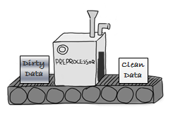
I Preprocessing
Data cleaning
Fill in missing values, smooth noisy data, identify or remove outliers, and resolve inconsistencies
Data integration
Integration of multiple databases, data cubes, or files
Data transformation
Normalization/ scaling and aggregation
Data reduction
Obtains reduced representation in volume but produces the same or similar analytical results

Slide 18
Data Normalization
Min-max normalization
Z-score normalization
Normalization by decimal scaling
Where, j is the smallest integer such that Max(| |) < 1

Slide 19
II Feature Engineering FE
“Feature engineering is the process of transforming raw data into features that better represent the underlying problem to the predictive models, resulting in improved accuracy on unseen data.” Jason Brownlee, Machine Learning Mastery.
As the models are getting better and better, the focus shifts to what is put into them.
Transforming data to create model’s inputs.

Slide 20
Feature Extraction
Dimension reduction
Principal component analysis (PCA)
Non-negative matrix factorization (NMF)
Kernel PCA
Graph-based kernel PCA
Generalized discriminant analysis (GDA)
Data smoothing
Wavelet transform
Ramer–Douglas–Peucker algorithm
Kernel smoother
Laplacian smoothing
Local regression, …

Slide 21

Feature Selection
Identifying features that are redundant or irrelevant
Improved model interpretability.

Slide 22
Feature selection Approaches
Wrapper – Search through the space of subsets, train a model for current subset, evaluate it on held-out data, and iterate. Simple greedy search heuristics:
Forward selection - start with an empty set, gradually add the “strongest” features
Random hill-climbing algorithm
Backward selection - Start with the full set, gradually remove the “weakest" features computationally expensive

Slide 23
Feature Selection Approaches
Filter – Use N most promising features according to ranking resulting from a proxy measure, e.g. from
Mutual information
Pearson correlation coefficient
ANOVA
Chi-Square
Embedded methods – Feature selection is a part of model construction
LASSO
RIDGE regression

Slide 24
Limitations on Feature Engineering
Adding many correlated predictors can decrease model performance.
More variables make models less interpretable.
Models have to be generalizable to other data
Too much feature engineering can lead to overfitting.
Close connection between feature engineering and cross-validation.

Slide 25
III Model Training
Model construction: Describing a set of predetermined classes
Each tuple/sample is assumed to belong to a predefined class, as determined by the class label attribute
The set of tuples used for model construction is training set.
The model is represented as classification rules, decision trees, or mathematical formulae.
Model usage: For classifying future or unknown objects.

Slide 26
Supervised vs. Unsupervised Learning
Supervised learning (classification/ regression)
Supervision: The training data (observations, measurements, etc.) are accompanied by labels indicating the class of the observations.
New data is classified based on the training set.
Unsupervised learning (clustering)
The class labels of training data is unknown.
Given a set of measurements, observations, etc. with the aim of establishing the existence of classes or clusters in the data.

Slide 27
Models for Analysis
Approaches
Classification
Regression
Techniques
Data mining
Machine learning
Artificial Intelligence (AI)

Slide 28
Classification
Y Normal Normal Normal Cancer Cancer Unknown =Y_new
sample1 sample2 sample3 sample4 sample5 … New sample
1 0.46 0.30 0.80 1.51 0.90 ... 0.34
2 -0.10 0.49 0.24 0.06 0.46 ... 0.43
3 0.15 0.74 0.04 0.10 0.20 ... -0.23
4 -0.45 -1.03 -0.79 -0.56 -0.32 ... -0.91
5 -0.06 1.06 1.35 1.09 -1.09 ... 1.23
X X_new
Each object (e.g. arrays or columns) associated with a class label (or response) Y ∈ {1, 2, …, K} and a feature vector (vector of predictor variables) of G measurements: X = (X₁, …, X_{G})
Aim: Predict Y_new from X_new.

Slide 29
Classifiers
A predictor or classifier partitions the space of gene expression profiles into K disjoint subsets, A₁, ..., A_{K}, such that for a sample with expression profile X=(X₁, ...,X_{G}) ∈ A_{k} the predicted class is k.
Classifiers are built from a learning set (LS)
L = (X₁, Y₁), ..., (X_{n},Y_{n})
Classifier C built from a learning set L:
C( . ,L): X → {1,2, ... ,K}
Predicted class for observation X:
C(X,L) = k if X is in A_{k}

Slide 30
Classification vs. Prediction

Slide 31
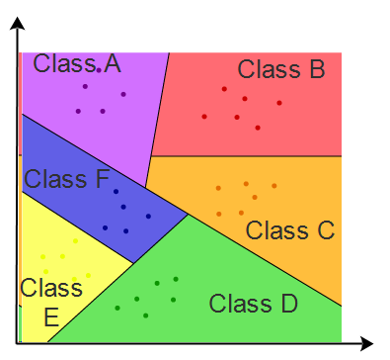
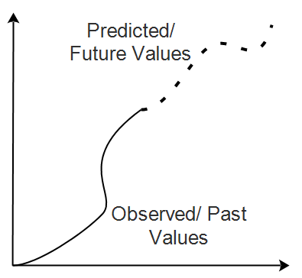
Classification | Prediction
Definition: A classification is a division or category in a system which divides things into groups or types | Definition: Prediction is a statement made about the future, forecasting unknown/ future figures
Model: Predicts categorical class labels (discrete or nominal) | Model: Models continuous-valued functions, i.e., predicts unknown or missing values
Methods: Linear Classifier LDA SVM Decision trees Bayesian Classifier Artificial Neural network Kernel estimation k-nearest neighbor | Methods: Linear Regression Non linear regression Poisson regression Generalized linear model Log-linear models Regression trees
Applications : Email spam filtering Cancer diagnosis Voice classification (for Siri type applications) Video classification (for uploaded videos on youtube, etc.) | Applications : Credit approval Target marketing Fault avoidance Medical diagnosis Fraud detection

Slide 32
Regression
Models the relationship between one or more independent or predictor variables and a dependent or response variable
Linear regression: Involves a response variable y and a single predictor variable x，y = w₀ + w₁x
Where, w₀ (y-intercept) and w₁ (slope) are regression coefficients
Method of least squares: estimates the best-fitting straight line
Multiple linear regression: Involves more than one predictor variable
Training data is of the form (X₁, y₁), (X₂, y₂),…, (X_{|D|}, y_{|D|})
Ex. For 2-D data, we may have: y = w₀ + w₁ x₁+ w₂ x₂
Solvable by extension of least square method or using SAS, S-Plus
Many nonlinear functions can be transformed into the above

Slide 33
Issues regarding Models for Analysis
Accuracy
Classifier accuracy and predictor accuracy
Speed and scalability
Time to construct the model (training time)
Time to use the model (classification/prediction time)
Robustness
Handling noise and missing values
Scalability
Efficiency in disk-resident databases
Interpretability
Understanding and insight provided by the model
Other measures, e.g., goodness of rules, such as decision tree size or compactness of classification rules.

Slide 34
IV Model Optimization
Tuning model to reduce error
Models parameter optimization
Meta-heuristics approaches
PSO
GA
ABC, …
Validation
K-fold cross validation
Monte-carlo method

Slide 35
V Performance Evaluation
Model verification
Accuracy measures
MAPE, MAE, RMSE, MSE, …

Slide 36
6. Results interpretation
The most important step.
First, check:
Does it help you with any objections that may have been raised initially?
Are any of the results limiting, or inconclusive?
If this is the case, may have to conduct further research.
Have any new questions been revealed that weren’t obvious before?
For every company to be successful, it needs experts who can interpret the analysis results.

Slide 37
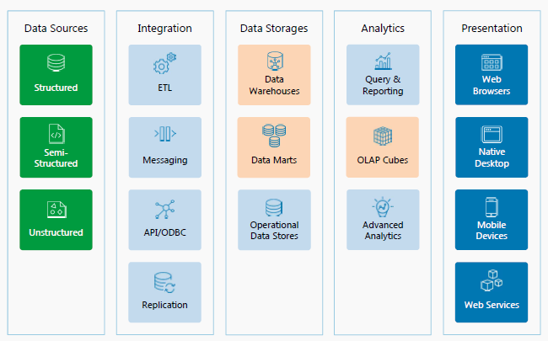

Slide 38
Types of Data Analytics

Slide 39
Decision Models
Model:
An abstraction or representation of a real system, idea, or object
Captures the most important features
Can be a written or verbal description, a visual display, a mathematical formula, or a spreadsheet representation

Slide 40
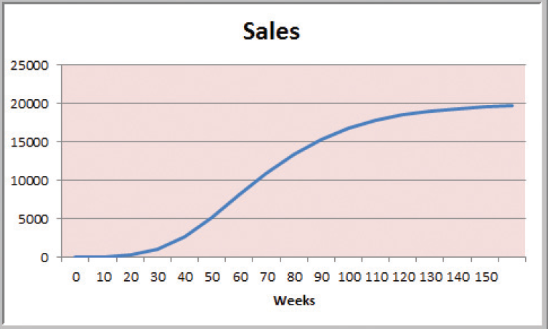
Decision Models

Slide 41
Decision Models
A decision model is a model used to understand, analyze, or facilitate decision making.
Types of model input
Data
Uncontrollable variables
Decision variables (controllable).

Slide 42
Decision Models
Descriptive Decision Models
Simply tell “what is” and describe relationships.
Do not tell managers what to do.

Slide 43
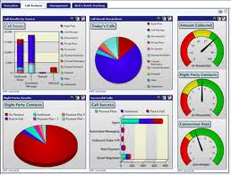
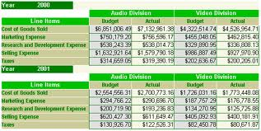
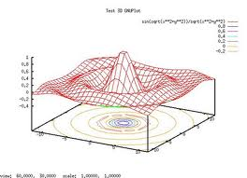
Descriptive Analytics
Descriptive analytics, such as reporting/OLAP, dashboards, and data visualization, have been widely used for some time.
They are the core of traditional BI.
What has occurred?
Descriptive analytics, such as data visualization, is important in helping users interpret the output from predictive and predictive analytics.
Notes:
Descriptive analytics, such as reporting/OLAP, dashboards, and data visualization, have been widely used for some time. They are the core of traditional BI.

Slide 44
Decision Models
Predictive Decision Models often incorporate uncertainty to help managers analyze risk.
Aim to predict what will happen in the future.
Uncertainty is imperfect knowledge of what will happen in the future.
Risk is associated with the consequences of what actually happens.

Slide 45
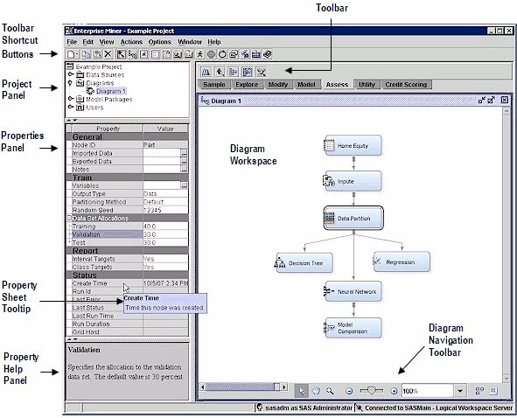
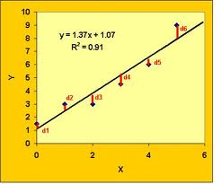
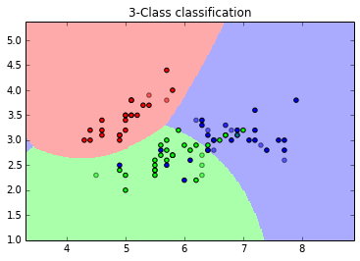
Predictive Analytics
Algorithms for predictive analytics, such as regression analysis, machine learning, and artificial neural networks, have also been around for some time.
Prescriptive analytics are often referred to as advanced analytics.
What will occur?
Marketing is the target for many predictive analytics applications.
Descriptive analytics, such as data visualization, is important in helping users interpret the output from predictive and prescriptive analytics.
Notes:
Algorithms for predictive analytics, such as regression analysis, machine learning, and neural networks, have also been around for some time. Recently, however, software products have made them much easier to understand and use. They have also been integrated into specific applications, such as for campaign management. Marketing is the target for many predictive analytics applications. Descriptive analytics, such as data visualization, is important in helping users interpret the output from predictive and predictive analytics. Prescriptive analytics are often referred to as advanced analytics.

Slide 46
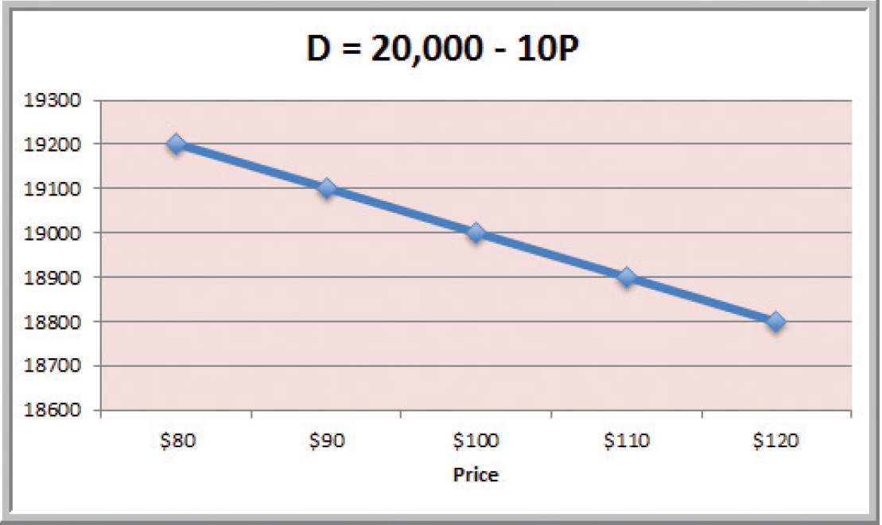
Decision Models
A Linear Demand Prediction Model
As price increases, demand falls.

Slide 47
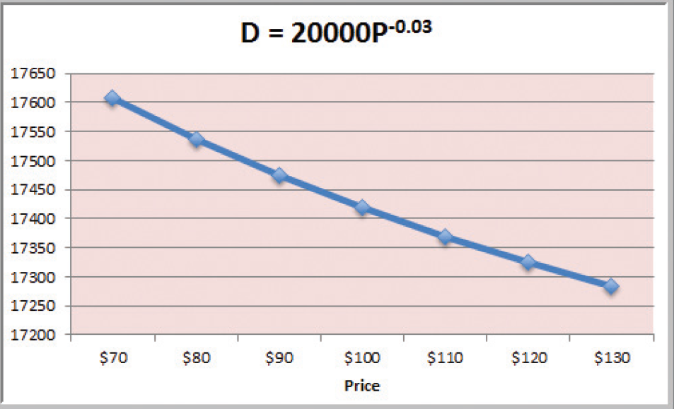
Decision Models
A Nonlinear Demand Prediction Model
Assumes price elasticity (constant ratio of % change in demand to % change in price)

Slide 48
Decision Models
Prescriptive Decision Models help decision makers identify the best solution.
Optimization - finding values of decision variables that minimize (or maximize) something such as cost (or profit).
Objective function - the equation that minimizes (or maximizes) the quantity of interest.
Constraints - limitations or restrictions.
Optimal solution - values of the decision variables at the minimum (or maximum) point.

Slide 49
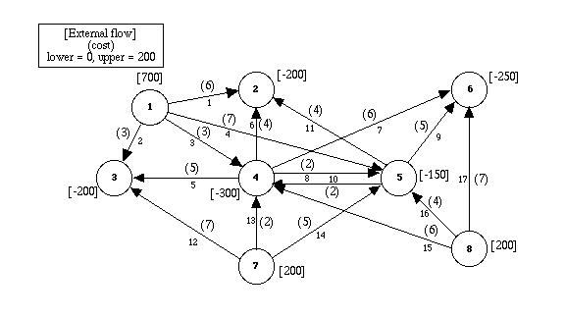
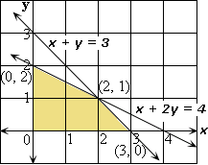
Prescriptive Analytics
Prescriptive analytics are often referred to as advanced analytics.
Regression analysis, machine learning, and neural networks
Often for the allocation of scarce resources
What should occur?
For example, the use of mathematical programming for revenue management is common for organizations that have “perishable” goods (e.g., rental cars, hotel rooms, airline seats).
Harrah’s has been using revenue management for hotel room pricing for some time.
Notes:
Prescriptive analytics provide an optimal solution, often for the allocation of scarce resources. They, too, have been in academia for a long time but are now finding wider use in practice. For example, the use of mathematical programming for revenue management is common for organizations that have “perishable” goods (e.g., rental cars, hotel rooms, airline seats). Harrah’s has been using revenue management for hotel room pricing for some time.

Slide 50
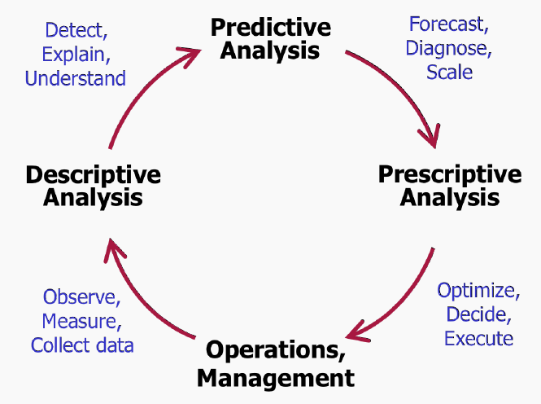
Data Analytics Cycle

Slide 51
Subsets of Data Analytics

Slide 52


Subsets of Data Analytics
Business intelligence (BI)
Big data analytics

Slide 53
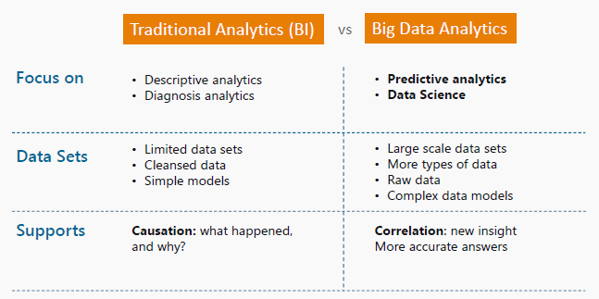
Business Intelligence vs. Big Data Analytics

Slide 54
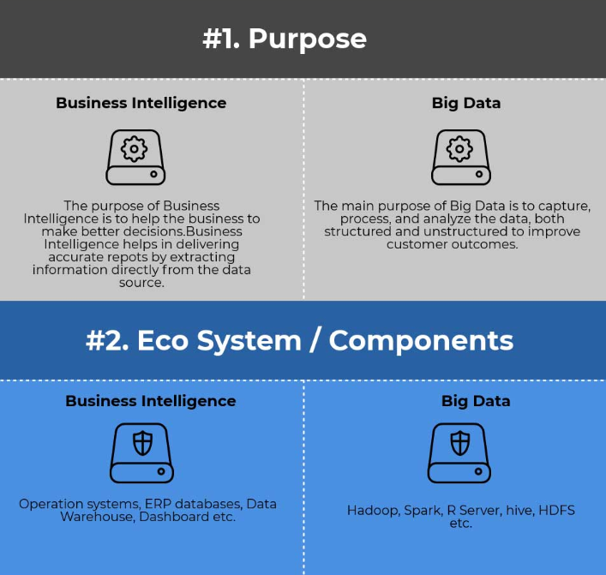

Slide 55
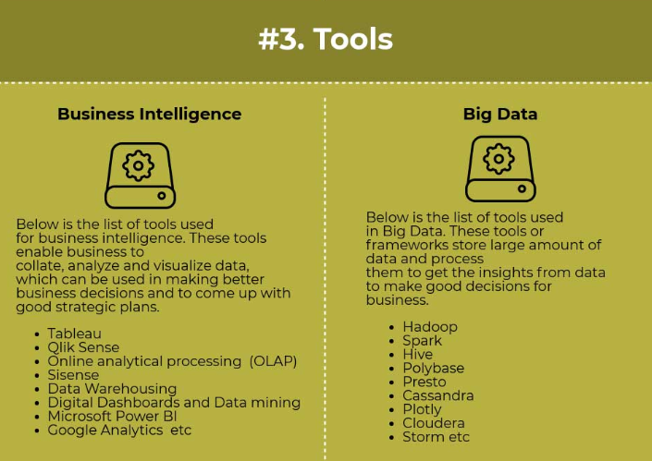

Slide 56
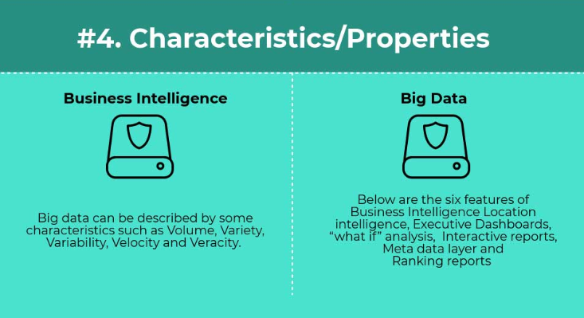

Slide 57
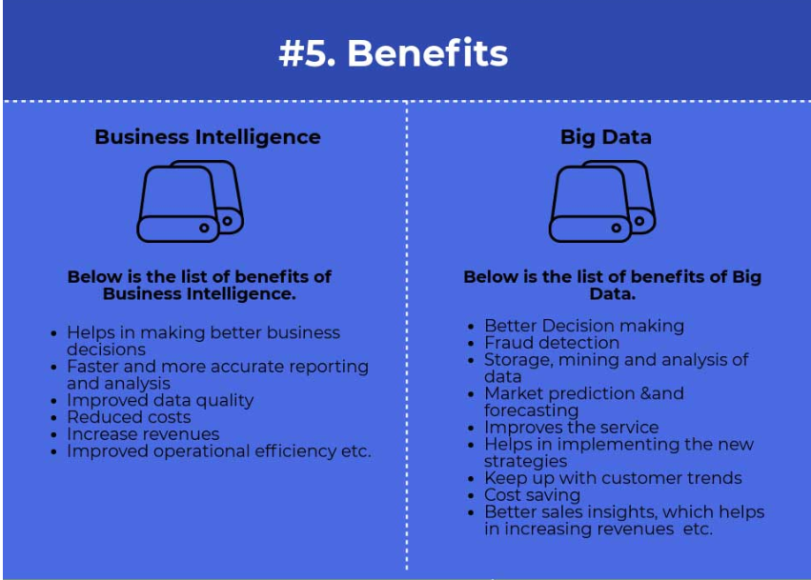

Slide 58
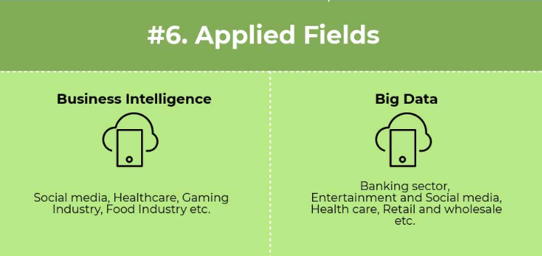

Slide 59
Business Intelligence Applications
Analysis of clickstream data
Customer profitability analysis
Customer segmentation analysis
Product recommendations
Campaign management
Pricing
Forecasting
Dashboards

Slide 60
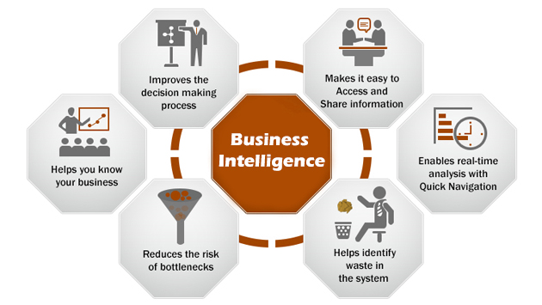

Slide 61
Business Intelligence Applications
Business intelligence is important:
Predict customer trends and behaviors
Analyze, interpret and deliver data in meaningful ways
Increase business productivity
Drive effective decision-making
Enables business experts:
Understand business direction and objectives
Explore the meaning behind the numbers and figures in data

Slide 62
Business Intelligence Applications
Enables business experts:
Analyze the causes of certain events based on data findings
Present technical insights using easy-to-understand language
Contribute to business decision-making by offering educated opinions

Slide 63
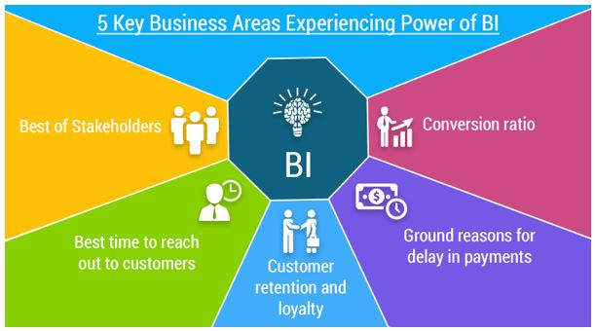

Slide 64
Big Data Analytics Applications
Information from multiple internal and external sources:
Transactions
Social media
Enterprise content
Sensors
Mobile devices
Companies leverage data to adapt products and services to:
Meet customer needs
Optimize operations
Optimize infrastructure
Find new sources of revenue
Can reveal more patterns and anomalies

Slide 65
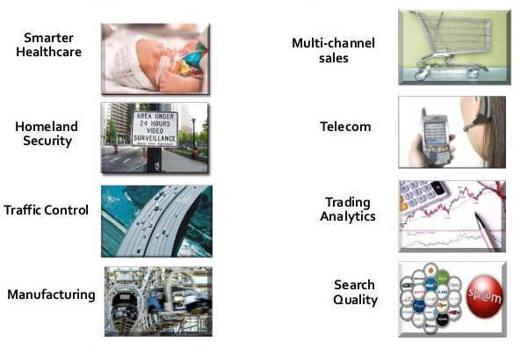
Applications of Big Data Analytics

Slide 66
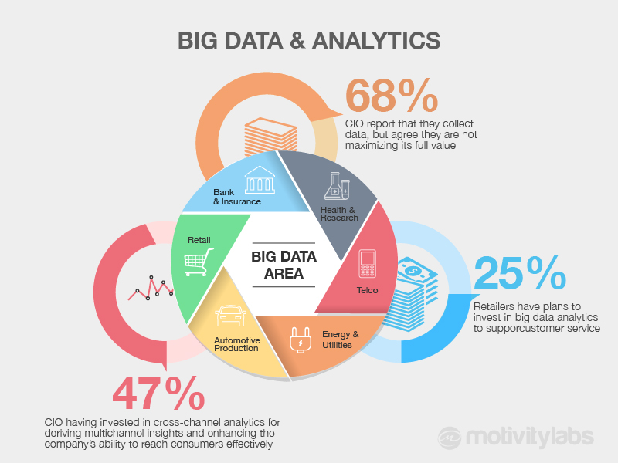

Slide 67
Concluding Remarks
Data analysis helps in getting useful insights that help in:
Better decision making
Long term planning

Slide 68
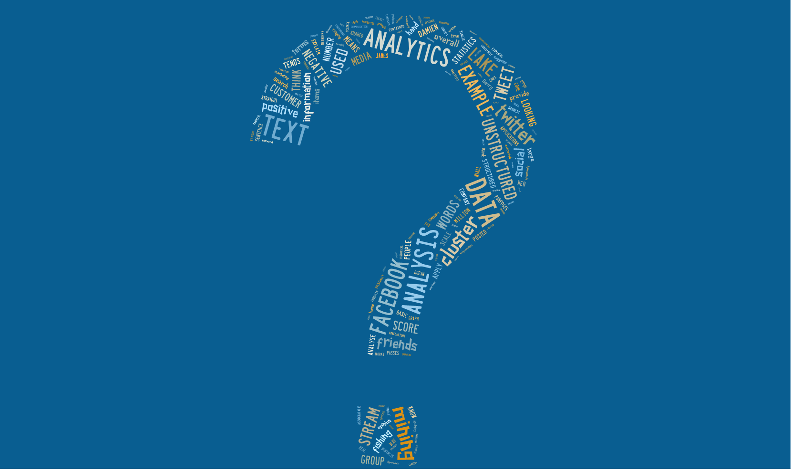

Slide 69


Data Analytics vs. Statistical Analysis
Data Analytics
Utilizes data mining techniques
Identifies inexplicable or novel relationships/trends
Seeks to visualize the data to allow the observation of relationships/trends
Statistical Analysis
Utilizes statistical and/or mathematical techniques
Used based on theoretical foundation
Seeks to identify a significant level to address hypotheses or RQs

Slide 70
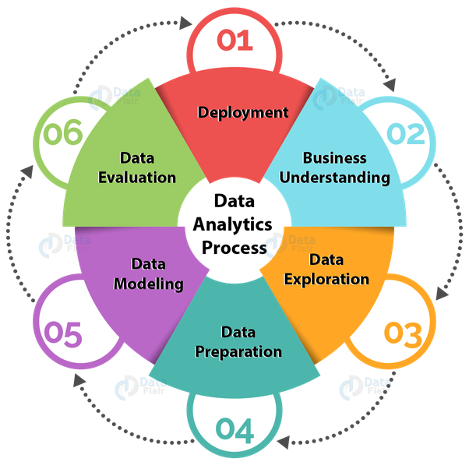

Slide 71
